Slide 1
AIRO
MEETING
April 26, 2017

Slide 2
PRODUCTIVITY FUNDING FORMULA
Productivity Measures
EFFECTIVENESS
80%
AFFORDABILITY
20%
ADJUSTMENT
EFFICIENCY
+/- 2%
METRICS
METRICS
METRICS
METRICS
Credentials
Progression
Transfer Success
Gateway Course Success
Non-Credit Workforce Training
Post Completion Success
Time to Degree
Credits at Completion
Research (4 Year Only)
Diseconomies of Scale
(2 Year Only)
Core Expense Ratio
Faculty to Admin Salary Ratio
Please note that Post-Completion Success is still being considered as a possible metric under the effectiveness category.

Slide 3
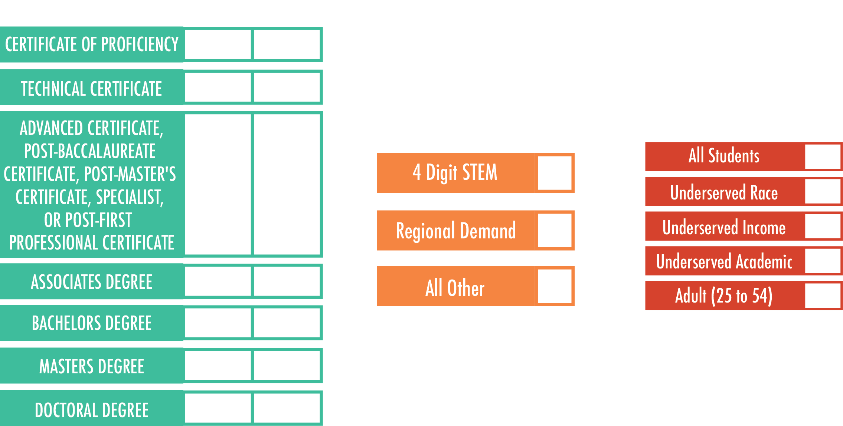
CREDENTIALS
40% of Effectiveness
(32% of Total)
High Demand
Please note that Non-Credit Workforce Hours will also be taken into consideration under the credentials metric

Slide 4
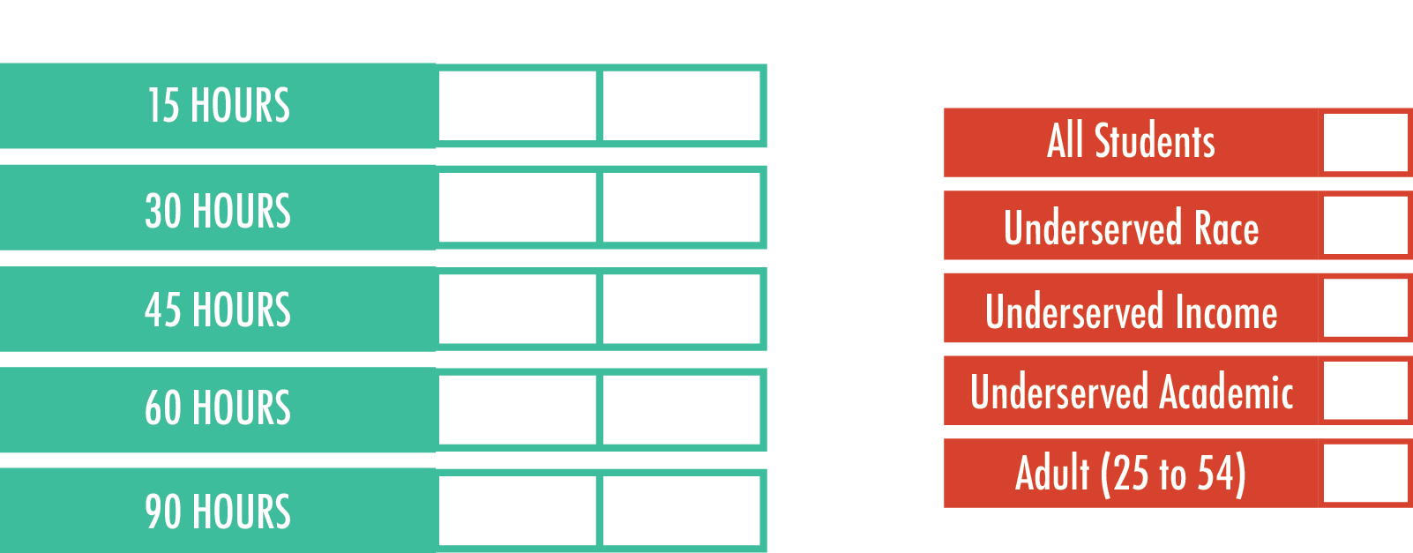
PROGRESSION
30% of Effectiveness
(24% of Total)

Slide 5
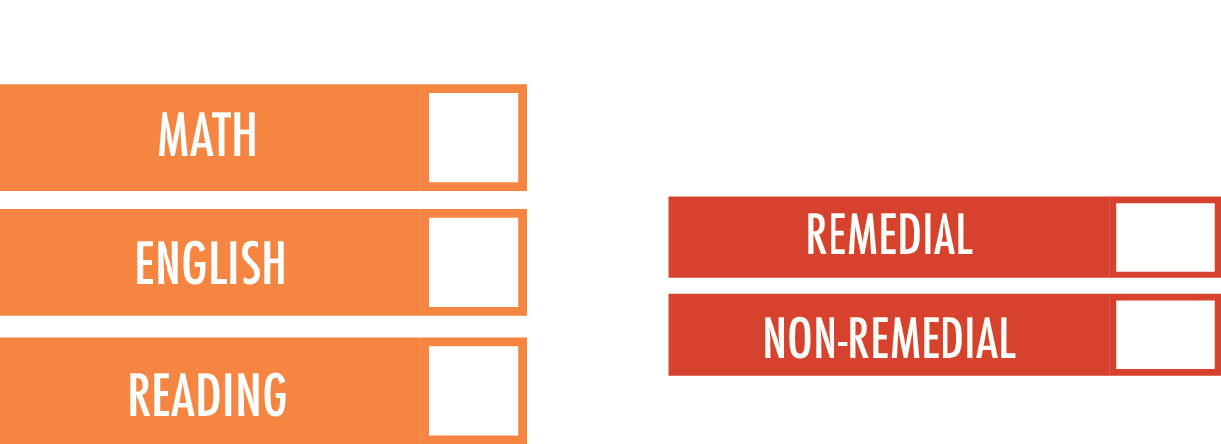
GATEWAY COURSE SUCCESS
15% of Effectiveness
(12% of Total)

Slide 6
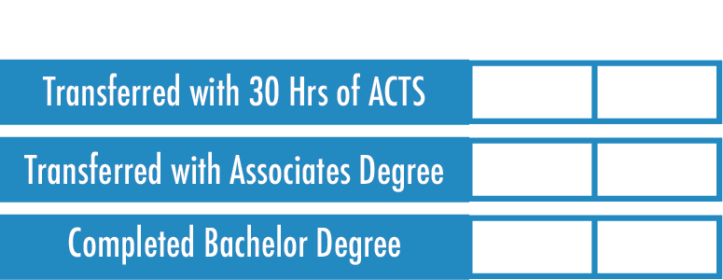
TRANSFER STUDENTS
15% of Effectiveness
(12% of Total)

Slide 7
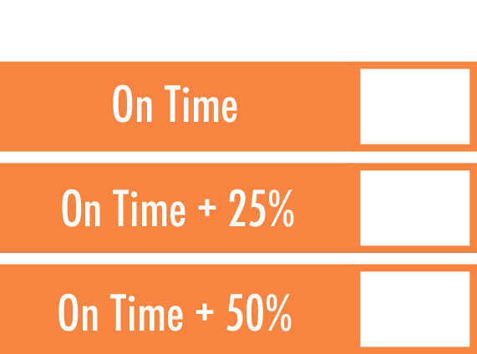
TIME TO DEGREE
50% of Affordability
(10% of Total)

Slide 8
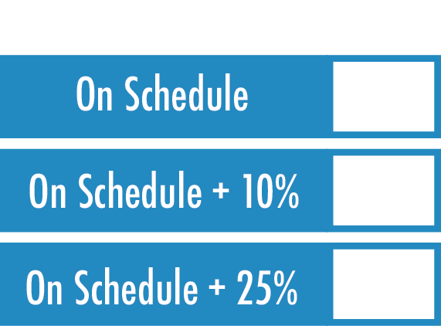
CREDITS AT COMPLETION
50% of Affordability
(10% of Total)

Slide 9
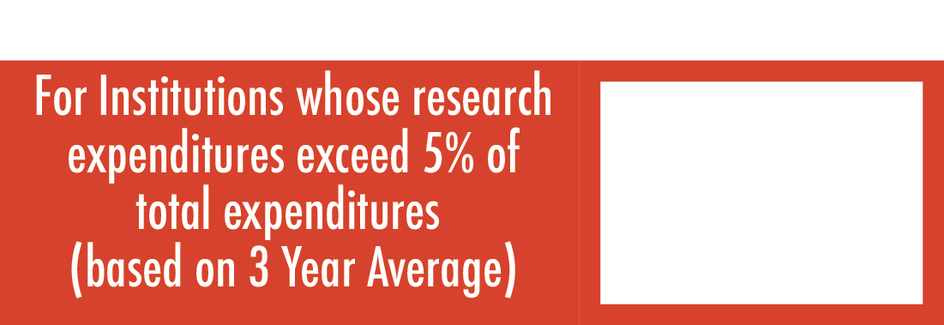
RESEARCH ADJUSTMENT
Four Year Institutions Only

Slide 10
DISECONOMIES OF SCALE ADJUSTMENT
Two Year Institutions Only
Between AVERAGE and AVERAGE -15%
Between AVERAGE -15.01% and AVERAGE -30%
Less than Average -30.01%

Slide 11
CORE EXPENSE RATIO
50% of Efficiency
Deviation from Peer Group | Application to Effectiveness Score
Below -20.01% | 0.98
-15.01% to -20% | 0.985
-10.01% to -15% | 0.99
-5.01% to -10% | 0.995
-5% to 5% | 1
5.01% to 10% | 1.005
10.01% to 15% | 1.01
15.01% to 20% | 1.015
Above 20.01% | 1.02

Slide 12
FACULTY TO ADMIN SALARY RATIO
50% of Efficiency
Deviation from Peer Group | Application to Effectiveness Score
Below -20.01% | 0.98
-15.01% to -20% | 0.985
-10.01% to -15% | 0.99
-5.01% to -10% | 0.995
-5% to 5% | 1
5.01% to 10% | 1.005
10.01% to 15% | 1.01
15.01% to 20% | 1.015
Above 20.01% | 1.02

Slide 13
METRICS TO BE DETERMINED

Slide 14
TOTAL FUNDING RECOMMENDATIONS
+
=
PRIOR YEAR FUNDING
NEW STATE FUNDING
REALLOCATED FUNDING
TOTAL FUNDING RECOMMENDATION
+
Change in Productivity is limited to a 2% increase or decrease annually.

